Slide 1
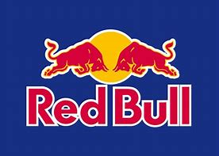
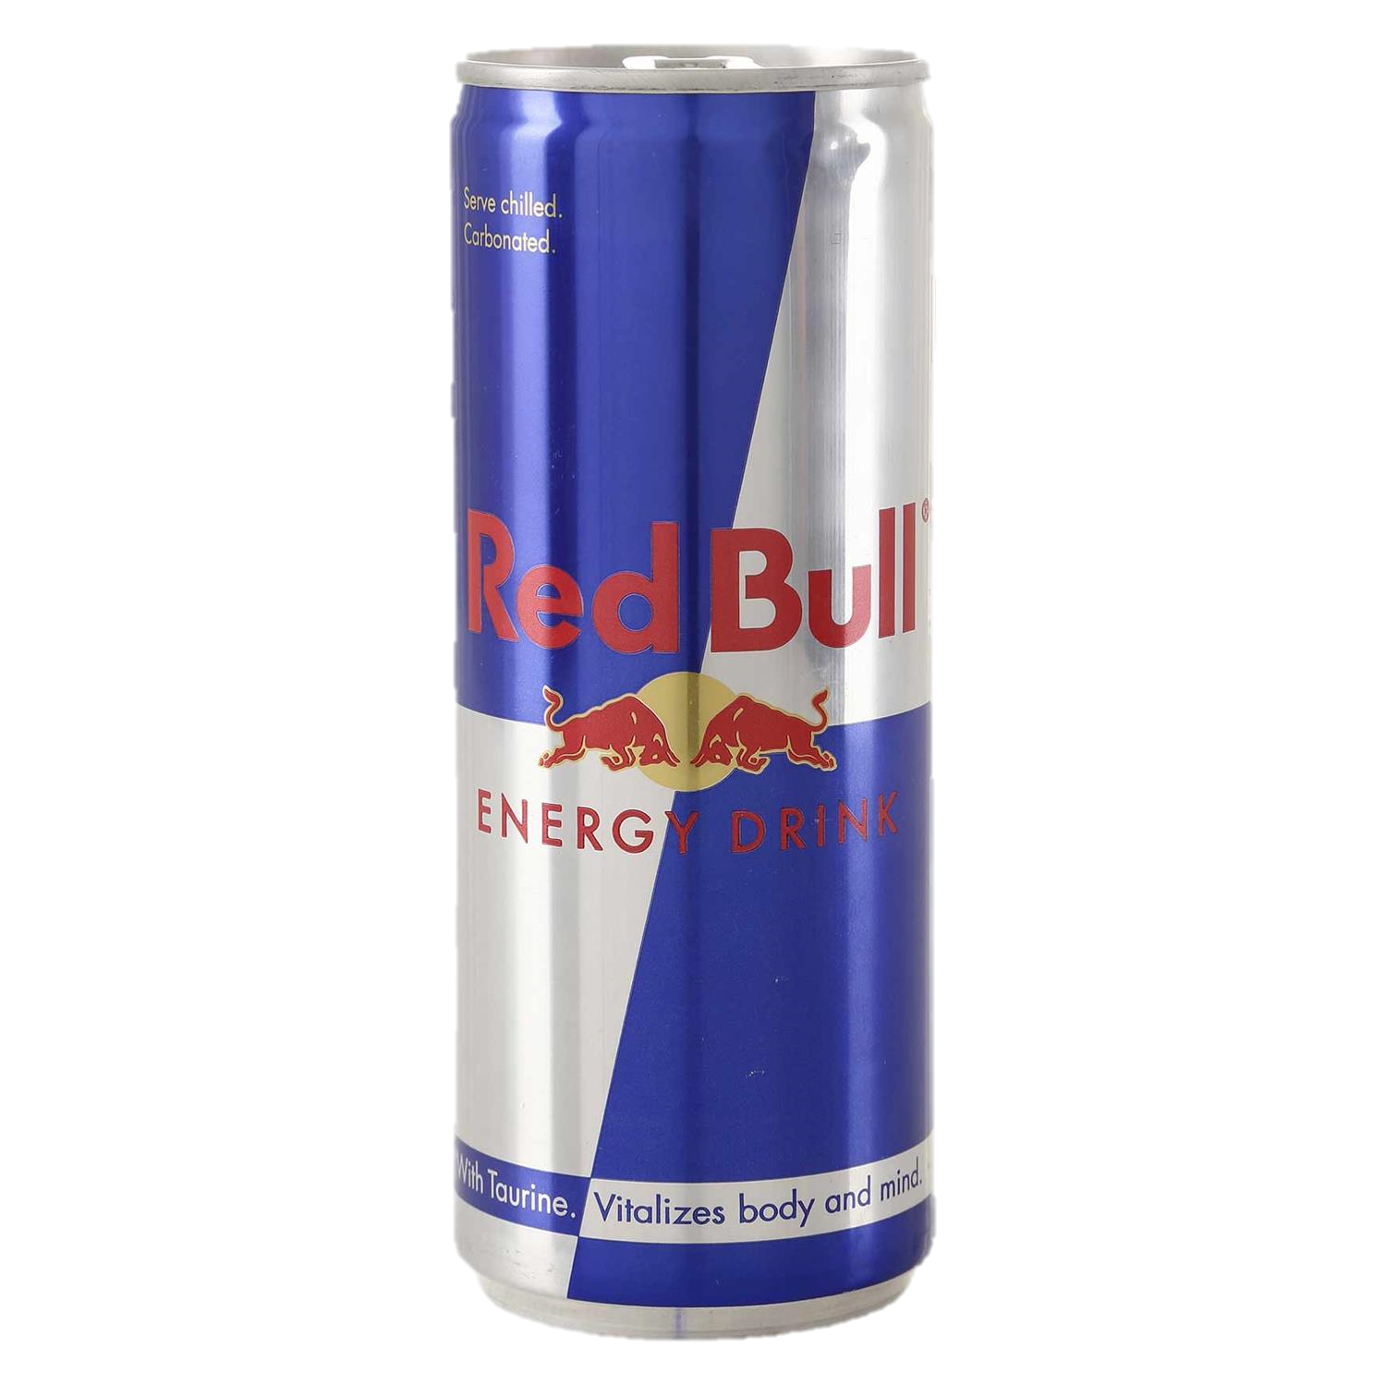
Where does
RedBull
come from ?

Slide 2
Summary
Introduction to RedBull
Logo and cans
Risks of the drink
Advertising
Imposed restrictions

Slide 3
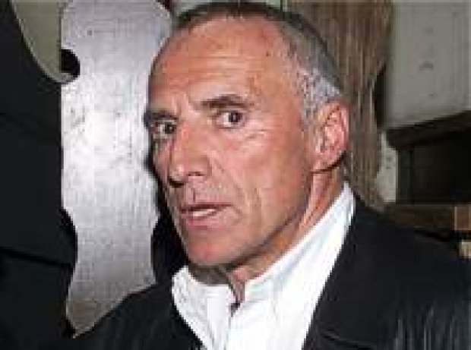
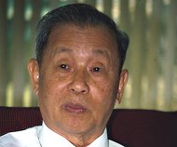
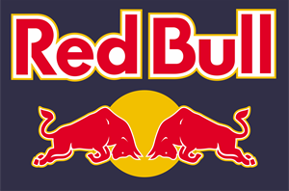
Introduction of RedBull | part 1
Dietrish Mateschitz
Chaleo Yoovidhya
Energy drink
1987
7 billions $ in 2016
«RedBull gives you wiiings ».

Slide 4
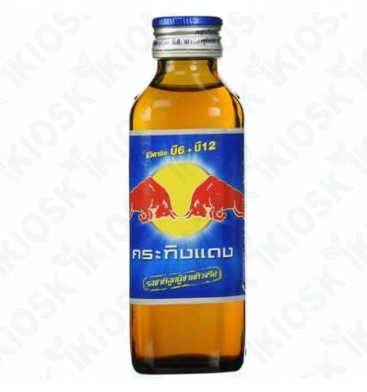
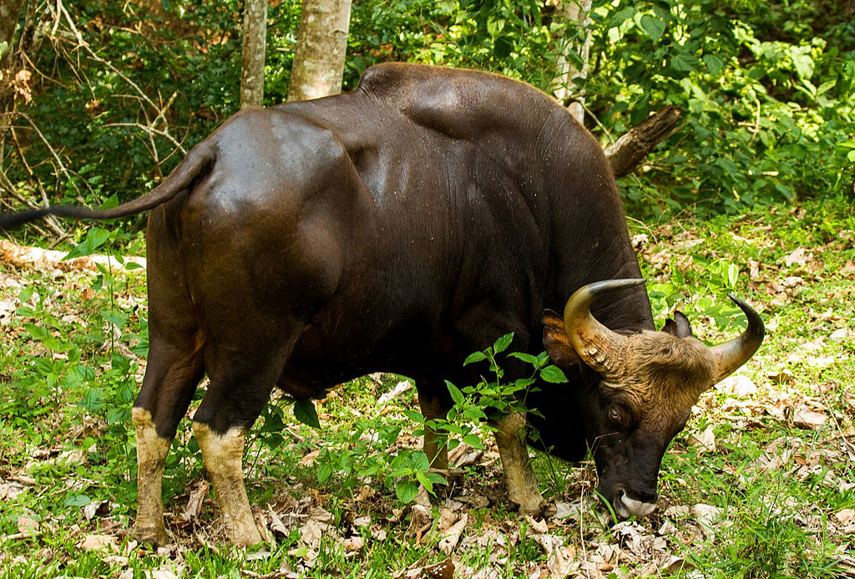
Introduction of RedBull | part 2
Red Bull
Krating Daeng (brand)
Krating Daeng (animal)

Slide 5
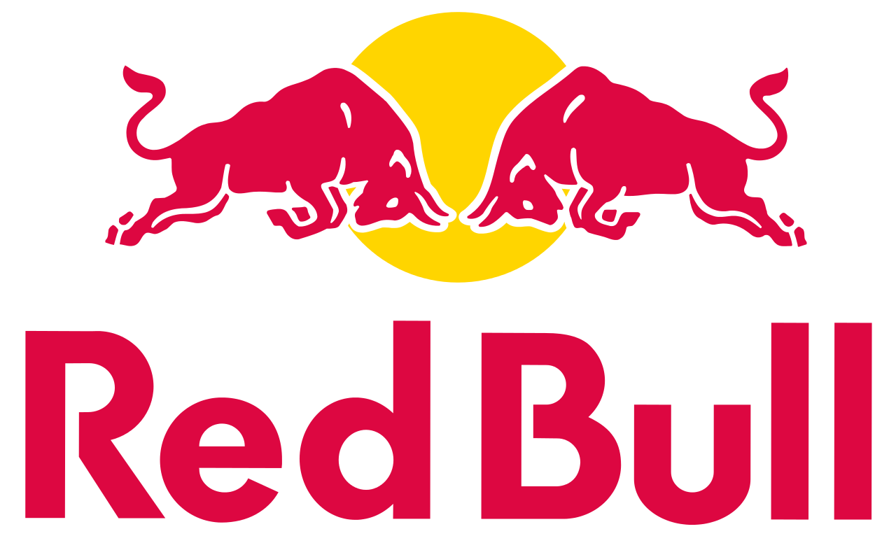
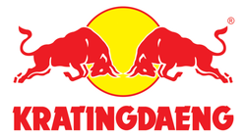
Logo and cans | part 1
Logo of Red Bull
Logo of Krating Daeng
Two red gaur
Yellow sun
Blue background
White /red side

Slide 6
Logo and cans | part 2
Slim blue silver can
Light and dark blue
in the background
Ingredients:
Taurine
Cafeine
Sugar
Water
Red Bull can

Slide 7

Risks of the drink
insomnia
nervousness
restlessness
fidgetiness
Heart Attack
excitement

Slide 8
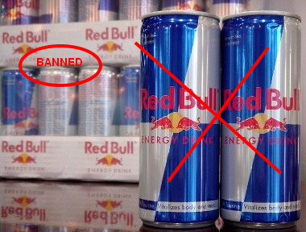
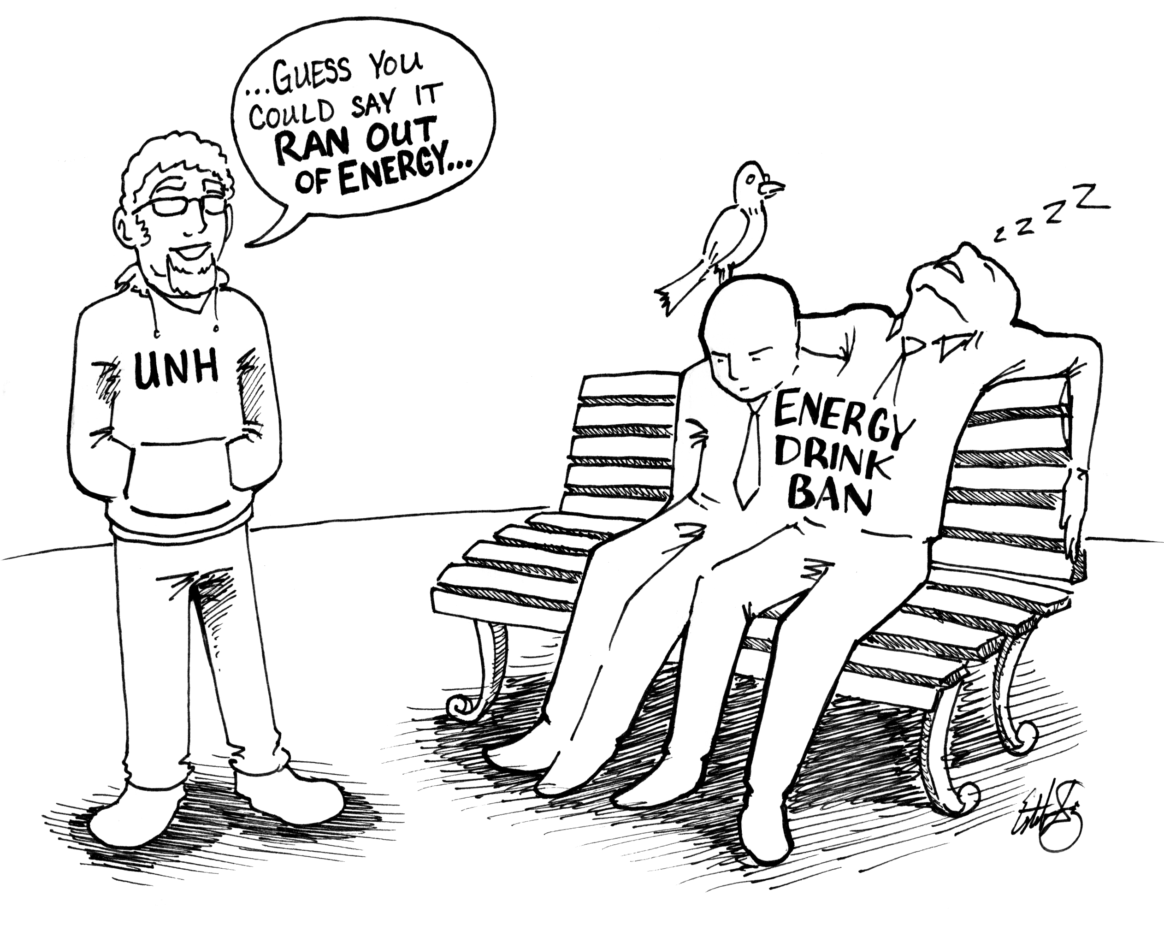
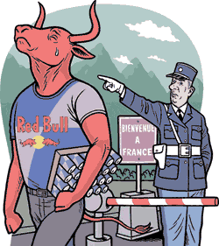
Imposed restrictions

Slide 9
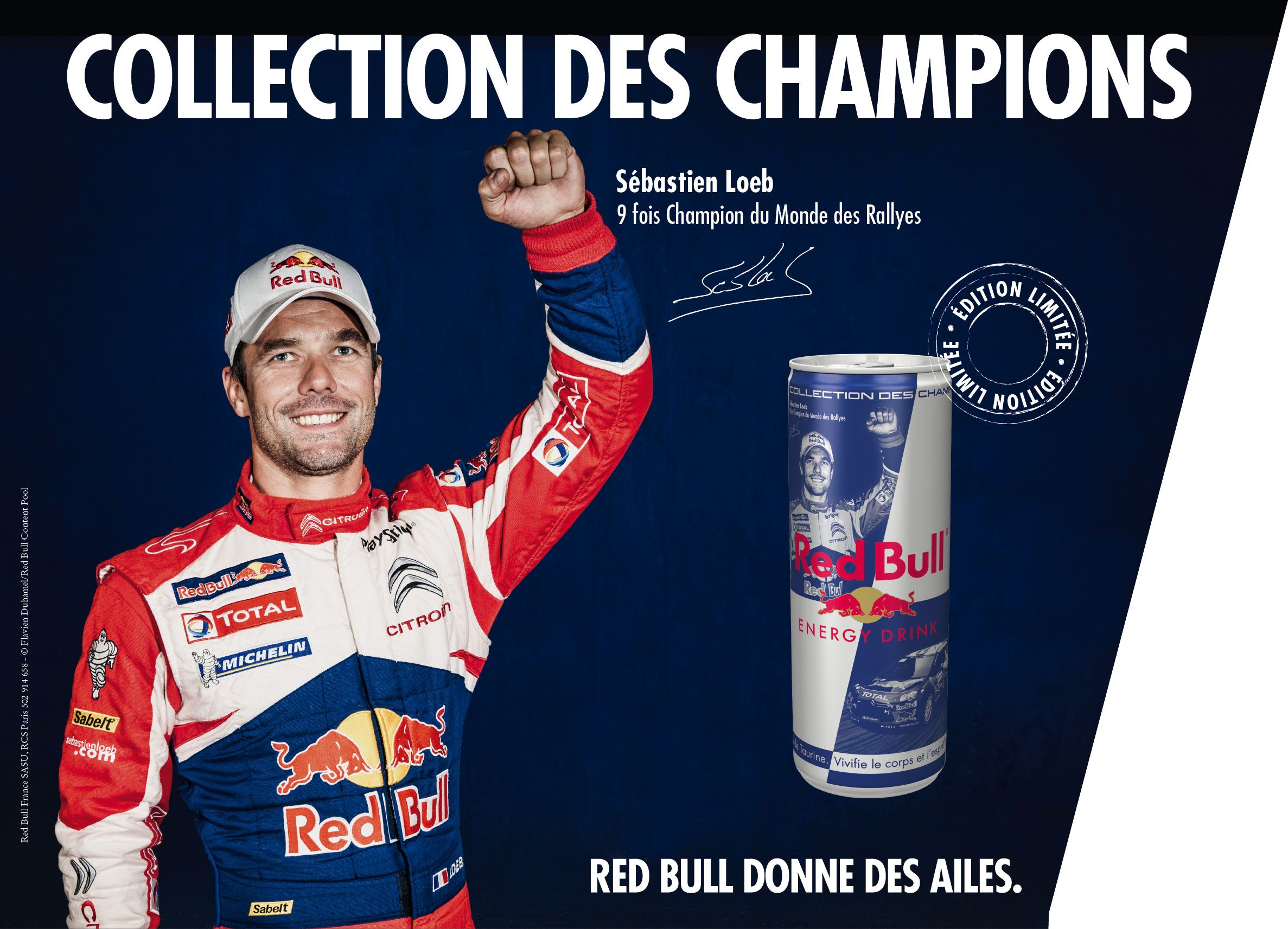
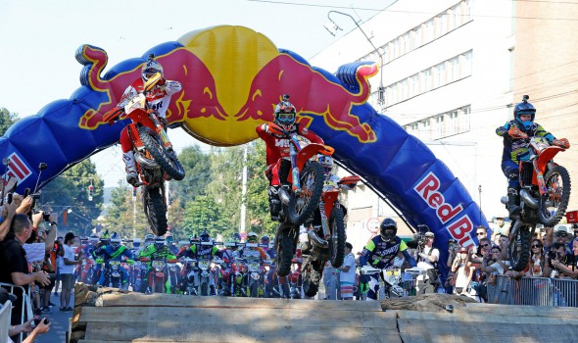
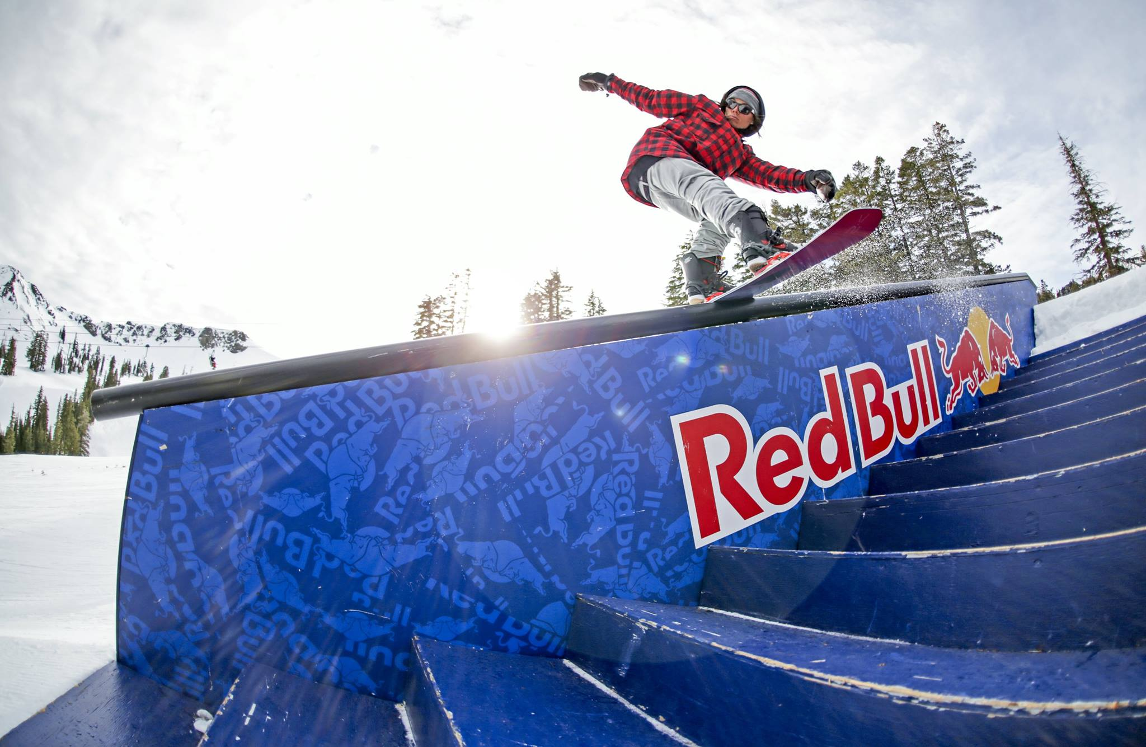

Advertising

Slide 10
General conclusion

